Slide 1
Angular Variables
Linear
Angular
Position
m
s
deg. or rad.
θ
Velocity
m/s
v
rad/s
ω
Acceleration
m/s
2
a
rad/s
2
α

Slide 2
Radians
θ
o
= 1 rad = 57.3
r
r
o
π
360
= 2
rad
θ
r
What is a radian?
  a unitless measure of angles
  the SI unit for angular measurement
1 radian is the angular distance covered when the arclength equals the radius

Slide 3
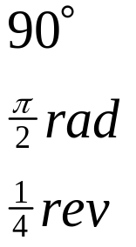
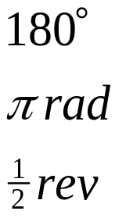
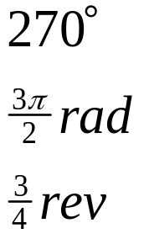
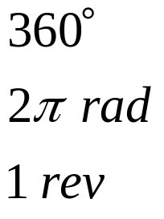

Slide 4
Measuring Angles
Relative Angles (joint angles) The angle between the longitudinal axis of two adjacent segments.
Absolute Angles
(segment angles) The angle between a segment and the right horizontal of the distal end.
Should be measured
consistently on same side
joint
straight fully extended
position is generally
defined as 0 degrees
Should be consistently
measured in the same
direction from a single
reference - either
horizontal or vertical

Slide 5
Measuring Angles
The typical data that we have to work with in biomechanics are the x and y locations of the segment endpoints. These are digitized from video or film.
Frame 1
(x1,y1)
Y
(x2,y2)
(x4,y4)
(x5,y5)
(x3,y3)
(0,0)
X

Slide 6
Tools for Measuring Body Angles
goniometers
electrogoniometers (aka Elgon)
potentiometers
Leighton Flexometer
gravity based assessment of absolute angle
ICR - Instantaneous Center of Rotation
often have translation of the bones as well
as rotation so the exact axis moves within jt

Slide 7
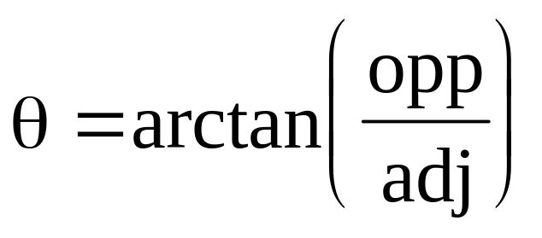
Calculating Absolute Angles
Absolute angles can be calculated from the endpoint coordinates by using the arctangent (inverse tangent) function.
(x₂,y₂)
opp
opp = y₂-y₁
adj = x₂-x₁
θ
(x₁,y₁)
adj

Slide 8
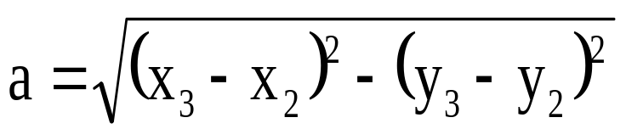
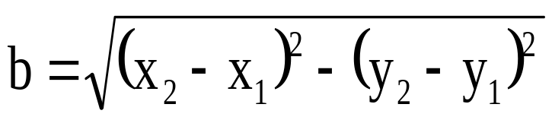
Calculating Relative Angles
Relative angles can be calculated in one of two ways:
1) Law of Cosines (useful if you have the segment lengths)
(x₃,y₃)
c² = a² + b² - 2ab(cosθ)
a
(x₂,y₂)
θ
c
b
(x₁,y₁)

Slide 9
Calculating Relative Angles
2) Calculated from two absolute angles. (useful if you have the absolute angles)
θ₃ = θ₁ + (180 - θ₂)
θ₁
θ₃
θ₂

Slide 10
CSB Gait Standards
Canadian
Society of
Biomechanics
Anatomical position is zero degrees.
θ_{hip}
θ_{trunk}
θ_{thigh}
θ_{knee}
RIGHT sagittal view
θ_{leg}
θ_{ankle}
θ_{foot}
segment angles
joint angles

Slide 11
CSB Gait Standards
Canadian
Society of
Biomechanics
Anatomical position is zero degrees.
θ_{hip}
θ_{trunk}
θ_{thigh}
LEFT sagittal view
θ_{knee}
θ_{leg}
θ_{ankle}
θ_{foot}
segment angles
joint angles

Slide 12
CSB Gait Standards (joint angles)
RH-reference frame only!
θ_{hip} = θ_{thigh} - θ_{trunk}
θ_{hip}> 0: flexed position θ_{hip}< 0: (hyper-)extended position
slope of θ_{hip} v. t > 0 flexing
slope of θ_{hip} v. t < 0 extending
θ_{knee} = θ_{thigh} - θ_{leg}
θ_{knee}> 0: flexed position θ_{knee}< 0: (hyper-)extended position
slope of θ_{knee} v. t > 0 flexing
slope of θ_{knee} v. t < 0 extending
θ_{ankle} = θ_{foot} - θ_{leg} - 90º
dorsiflexed + plantar flexed -
dorsiflexing (slope +) plantar flexing (slope -)

Slide 13
Angle Example
The following coordinates were digitized from the right lower extremity of a person walking. Calculate the thigh, leg and knee angles from these coordinates.
HIP (4,10)
KNEE (6,4)
ANKLE (5,0)

Slide 14
Angle Example
(4,10)
θ_{thigh}
(6,4)
θ_{leg}
(5,0)
segment angles

Slide 15
Angle Example
(4,10)
θ_{thigh}
(6,4)
θ_{leg}
(5,0)
segment angles

Slide 16
Angle Example
(4,10)
θ_{knee} = θ_{thigh} – θ_{leg}
θ_{knee} = 32º
θ_{thigh} = 108°
(6,4)
θ_{knee}
θ_{leg} = 76°
(5,0)
segment angles
joint angles

Slide 17
Angle Example – alternate soln.
a =
b =
c =
φ =
(4,10)
a
c
φ
(6,4)
b
θ_{knee}
(5,0)

Slide 18
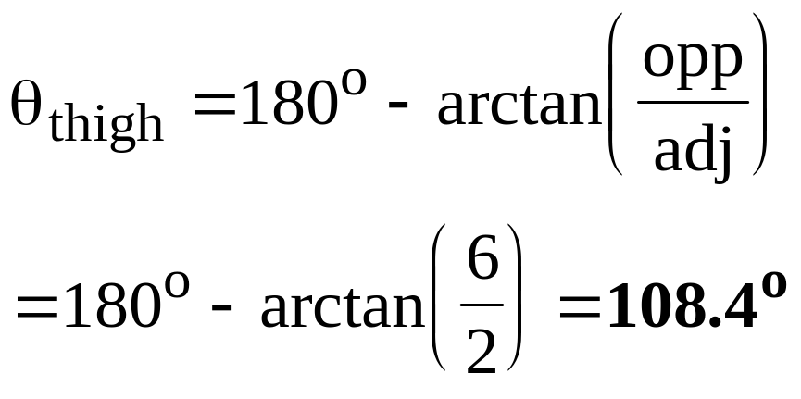
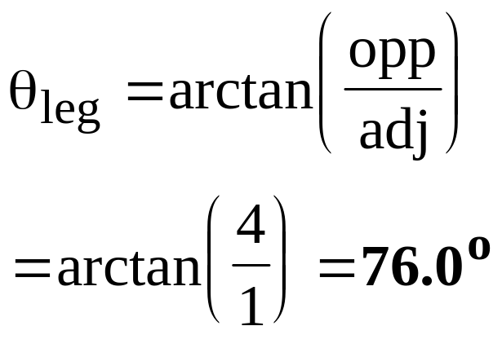
Angle Example
(4,10)
θ_{thigh}
(6,4)
θ_{leg}
(5,0)
segment angles

Slide 19
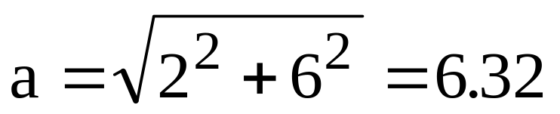
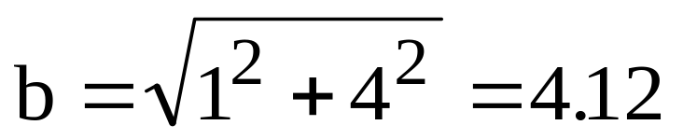
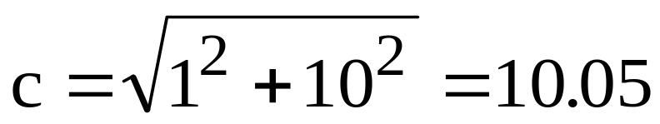
Angle Example
(4,10)
a
φ
(6,4)
c
θ_{knee}
(5,0)
b
joint angle (1)
c² = a² + b² - 2ab(cosφ)
10.05² = 6.32² + 4.12² - 2(6.32)(4.12)(cosφ)
θ_{knee}= 180º - φ = 180º - 147.8º = 32.3º

Slide 20
Angle Example
(4,10)
(6,4)
joint angle (2)
θ_{knee}
θ_{knee} = θ_{thigh} - θ_{leg}
(5,0)
θ_{knee} = 108.4º - 76.0º = 32.4º

Slide 21
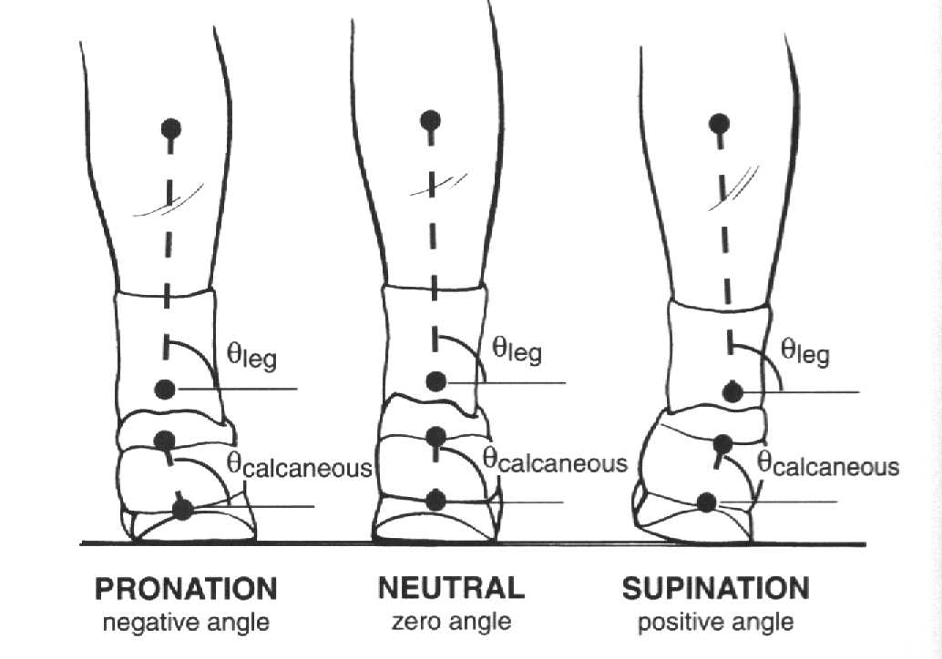
CSB Rearfoot Gait Standards
θ_{rearfoot} = θ_{leg} - θ_{calcaneous}

Slide 22
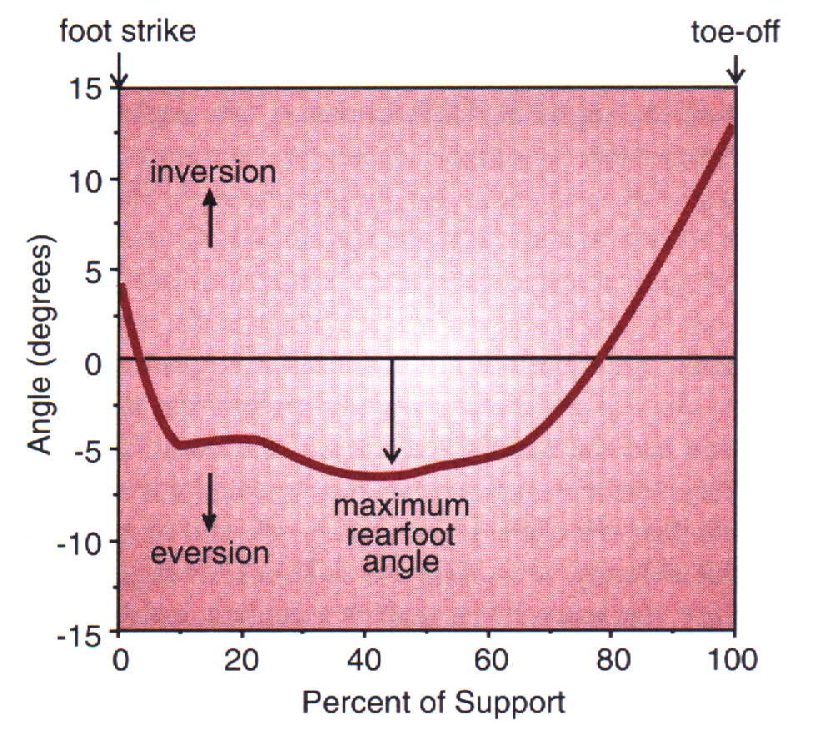
Typical Rearfoot Angle-Time Graph

Slide 23

Angular Motion Vectors
The representation of the angular motion vector is complicated by the fact that the motion is circular while vectors are represented by straight lines.

Slide 24
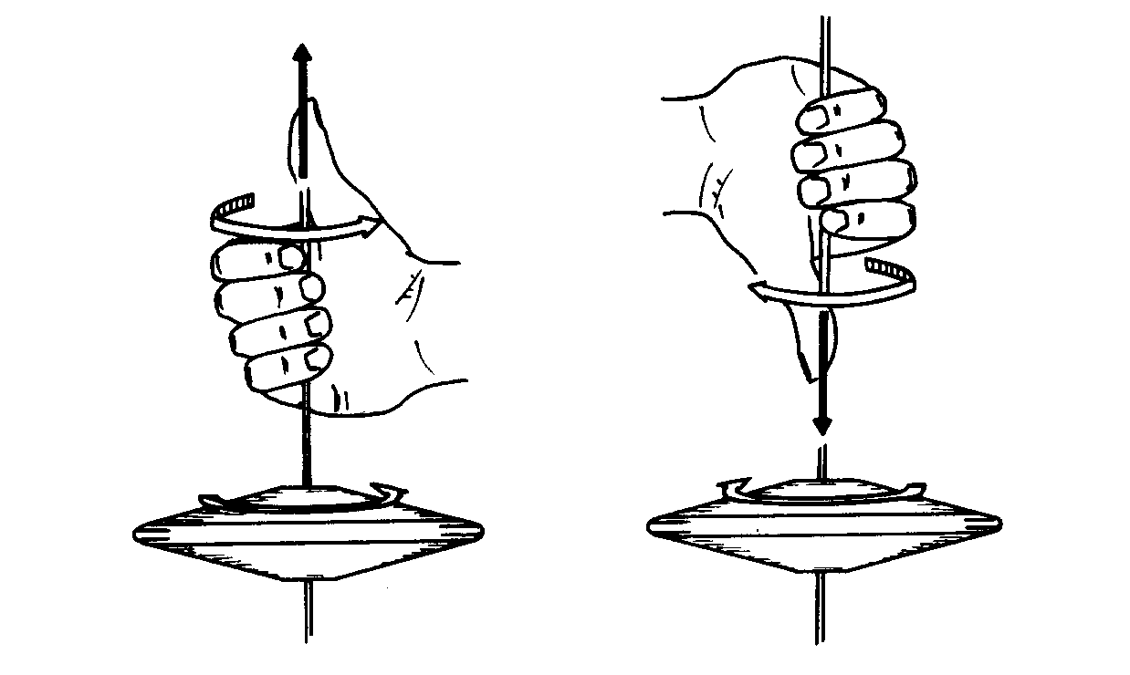
Angular Motion Vectors
Right Hand Rule: the vector is represented by an arrow drawn so that if curled fingers of the right hand point in the direction of the rotation, the direction of the
vector coincides
with the direction
of the extended
thumb.

Slide 25
Angular Motion Vectors
A segment rotating counterclockwise (CCW) has a positive value and is represented by a vector pointing out of the page.
+
-
A segment rotating clockwise (CW) has a negative value and is represented by a vector pointing into the page.

Slide 26
Angular Distance vs. Displacement
analogous to linear distance and displacement
angular distance
  length of the angular path taken along a path
angular displacement
  final angular position relative to initial position
  θ = θ_{f} - θ_{i}

Slide 27
Angular Distance vs. Displacement
Angular Distance
Angular Displacement

Slide 28
Angular Position
Example - Arm Curls
2
3
1,4
Consider 4 points in motion
1. Start
2. Top
3. Horiz on way down
4. End

Slide 29
Position 1: -90
Position 2: +75
Position 3: 0
Position 4: -90
NOTE: starting
point is NOT 0
2
3
1,4

Slide 30
Computing Angular
Distance and Displacement
2
φθ
1 to 2 165 +165
2 to 3 75 -75
3 to 4 90 -90
1 to 2 to 3 240 +90
1 to 2 to 3 to 4 330 0
3
1,4

Slide 31
Calculate:
angular distance (φ)
angular displacement (θ)
IN DEG,RAD, & REV
Given:
front somersault
overrotates 20
1
2
2.5
+20

Slide 32
Distance (φ)
Displacement (θ)

Slide 33
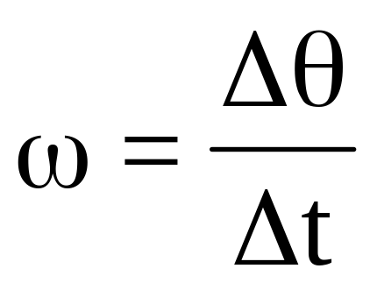
Angular Velocity (ω)
Angular velocity is the rate of change of angular position.
It indicates how fast the angle is changing.
Positive values indicate a counter clockwise rotation while negative values indicate a clockwise rotation.
units: rad/s or degrees/s

Slide 34
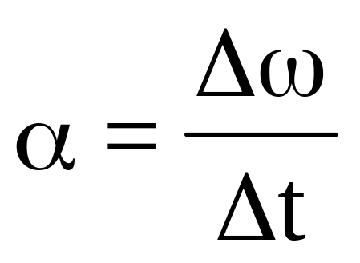
Angular Acceleration (α)
Angular acceleration is the rate of change of angular velocity.
It indicates how fast the angular velocity is changing.
The sign of the acceleration vector is independent of the direction of rotation.
units: rad/s² or degrees/s²

Slide 35
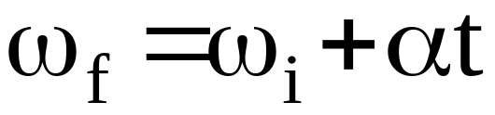
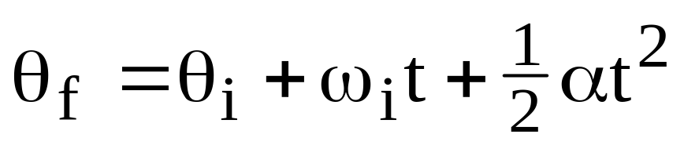
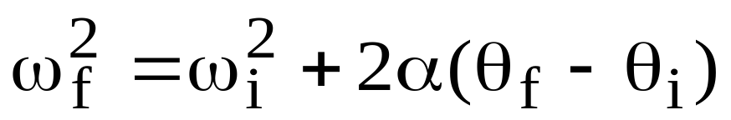
Equations of Constantly Accelerated Angular Motion
Eqn 1:
Eqn 2:
Eqn 3:

Slide 36
Angular to Linear
r
A
consider an arm rotating about the shoulder
B
Point B on the arm moves through a greater distance than point A, but the time of movement is the same. Therefore, the linear velocity (Δp/Δt) of point B is greater than point A.
The magnitude of this linear velocity is related to the distance from the axis of rotation (r).

Slide 37
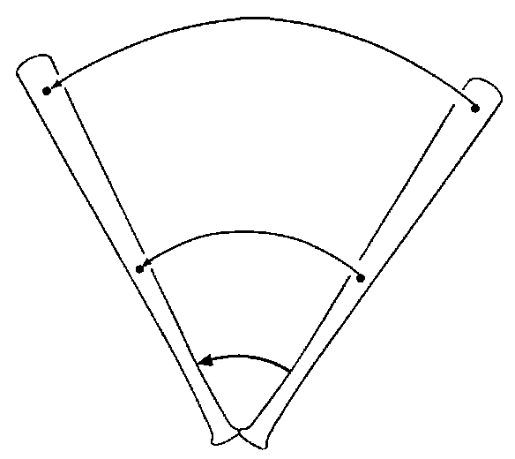
Angular to Linear
The following formula convert angular parameters to linear parameters:
s = θr
v = ωr
a_{t} = αr
a_{c} = ω²r or v²/r
Note: the angles must be measured in radians NOT degrees

Slide 38
θ to s (s = θr)
r
θr
The right horizontal is 0º and positive angles proceed counter-clockwise.
example: r = 1m, θ = 100º, What is s?
s = 100*1 = 100 m
NO!!! θ must be in radians
s = (100 deg* 1rad/57.3 deg)*1m = 1.75 m

Slide 39
ω to v (v = ωr)
hip
tangential velocity
radial axis
ankle
The direction of the velocity vector (v) is perpendicular to the radial axis and in the direction of the motion. This velocity is called the tangential velocity.
example: r = 1m, ω = 4 rad/sec, What is the magnitude of v?
v = 4rad/s*1m = 4 m/s

Slide 40
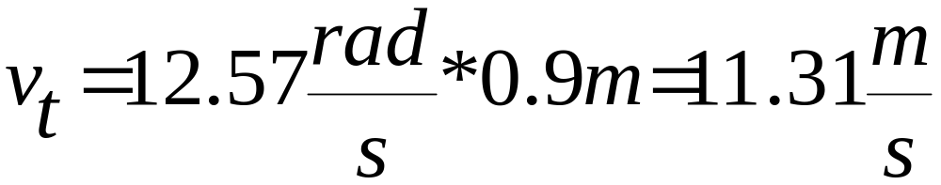
Bowling example
v_{t} = tangential velocity
ω = angular velocity
r = radius
Given ω = 720 deg/s at release
r = 0.9 m
Calculate v_{t}
Equation: v_{t} = ωr
ω
r
v_{t}
v_{t}
First convert deg/s to rad/s: 720deg*1rad/57.3deg = 12.57 rad/s

Slide 41
Batting example
v_{t} = ωr
choosing the right bat
Things to consider when you want to use a longer bat:
1) What is most important in swing?
- contact velocity
2) If you have a longer bat that doesn’t inhibit angular velocity then it is good - WHY?
3) If you are not strong enough to handle the longer bat then what happens to angular velocity? Contact velocity?

Slide 42
α to a_{t} (a_{t} = αr)
Increasing angular speed ccw: positive α.
Decreasing angular speed ccw: negative α.
Increasing angular speed cw: negative α.
Decreasing angular speed cw: positive α.
There is a tangential acceleration whenever the angular speed is changing.

Slide 43
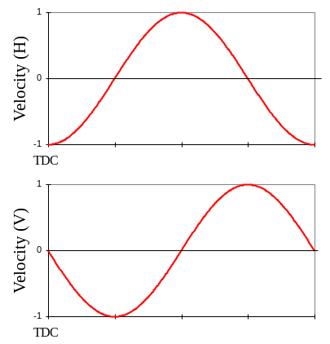
Centripetal Acceleration
TDC
ω is constant
By examining the components of the velocity it is clear that there is acceleration even when the angular velocity is constant.

Slide 44
α to a_{c} (a_{c} = ω²r or a_{c} = v²/r)
Even if the velocity vector is not changing magnitude, the direction of the vector is constantly changing during angular motion.
There is an acceleration toward the axis of rotation that accounts for this change in direction of the velocity vector.
This acceleration is called centripetal, axial, radial or normal acceleration.

Slide 45
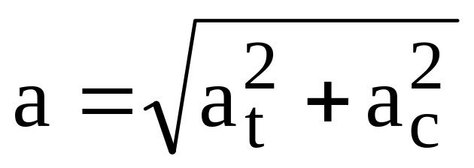
Resultant Linear Acceleration
Since the tangential acceleration and the centripetal acceleration are orthogonal (perpendicular), the magnitude of the resultant linear acceleration can be found using the Pythagorean Theorem:
a_{c}
a_{c}
a_{t}
a_{t}

